Slide 1
CS 2009 Design and Analysis of Algorithms
Waheed Ahmed
Email : waheedahmed@nu.edu.pk

Slide 2
Lecture 1: Introduction & Course Overview

Slide 3
About Me
Dr. Waheed Ahmed (Assistant Professor)
M.S. (Computer Science) FAST-NUCES 2013-2015
PhD (Computer Science) 2016 - 2022
Southeast University, China
ULM University, Germany

Slide 4
Grading Policy (CS 2009)
Assessment Type | Weight
Assignments: | 10
Midterms (Week 6 & Week 11) | 30 (15 each)
Project | 10
Final | 50

Slide 5
Text & Reference Books
Required Textbook
Thomas H. Cormen “Introduction to Algorithms” 3rd Edition
Reference Books
Anany Levitin “Introduction to the Design and Analysis of Algorithms” 3rd edition
Jon Kleinberg and Éva Tardos “Algorithm Design”
Sanjoy Dasgupta et al. “Algorithms”
Steven S. Skiena “The Algorithm Design Manual”

Slide 6
Contents & Tentative Schedule
Week | Topics
Week 1 & 2 | Basics of Algorithms, Mathematical Foundation, Growth of Function, Asymptotic Notations.
Week 3 & 4 | Divide and Conquer, Substitution Method, Recurrence-Tree Method, Master’s Method.
Week 5 | Sorting (Merge, Insertion, Quick, Heap, Counting, Radix, Bucket)
Week 6 | Mid term 1 Exam
Week 7 | Dynamic Programming

Slide 7
Contents & Tentative Schedule
Week | Topics
Week 8 | Dynamic Programming & Greedy Algorithms
Week 9, 10 & 12 | Graph Theory (Graph Categorization, Graph Terminology, Representation of Graphs, BFS & DFS, Strongly Connected Components, Greedy Algorithms: Kruskal’s Algorithm, Prim’s Algorithms, Bellman-Ford Algorithms, Dijkstra’s Algorithm)
Week 11 | Midterm 2
Week 13 & 14 | Geometric Algorithms (Introduction,Graham Scan, Close Points). String Matching
Week 15 & 16 | NP Complete Problems and Solutions using Approximation Algorithm, Amortized algorithms
Week 17 | Review & Project Presentations

Slide 8
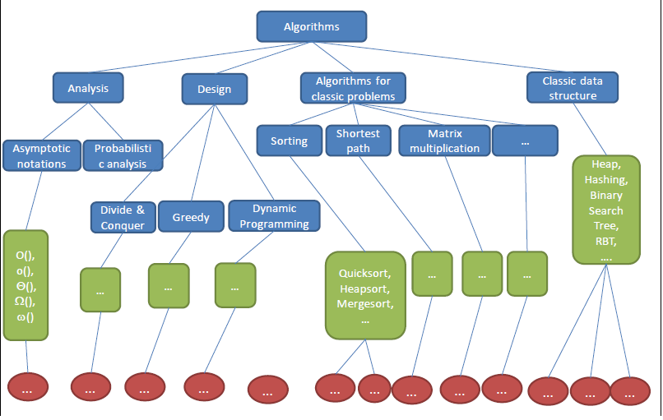
Knowledge tree

Slide 9
What is an algorithm?

Slide 10
What is Algorithm
Informally, an algorithm is any well-defined computational procedure that takes some value as input and produces some value as output. (Thomas H. CORMEN)
An algorithm is a sequence of computational steps for solving a problem.
E.g.
Multiply Two Numbers.
Algorithms to Sort Array.

Slide 11
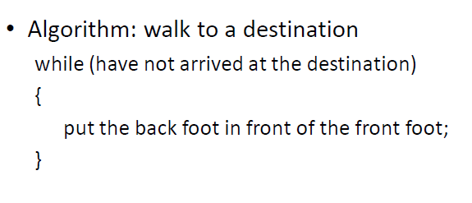
Examples of Algorithms - Walk

Slide 12
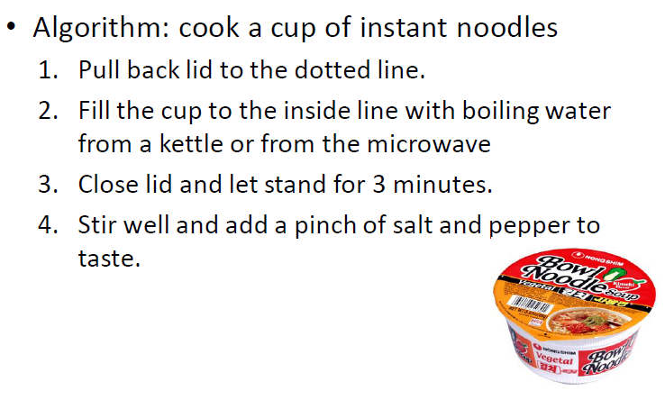
Examples of Algorithms – Cook Noodles

Slide 13
MULTIPLICATION: THE PROBLEM
Input: 2 numbers, x and y (n digits each)
Output: the product x · y
4456
x 1123
5004088

Slide 14
Why Study Algorithms ?

Slide 15
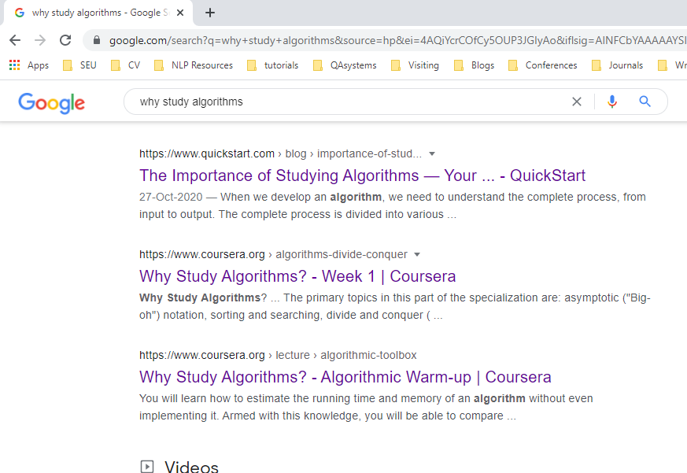
Web Search

Slide 16


Personalized Recommendation
More than 70% of what people watch on YouTube is determined by its recommendation algorithm.
News Feed, Friend Suggestions

Slide 17

Human Genome Project

Slide 18

Security E-commerce

Slide 19
Lot of Applications
Internet. Web search, Packet routing, distributed file sharing,...
Biology. Human genome project, protein folding, …
Data Mining. Text Classification, Text Clustering, Page Rank
Security. E-commerce, Cell phones, Voting machine
Web programing. Sorting Algorithms, Searching algorithms
Graphics. Video Games, Virtual Reality,
Social networks. Recommendations, news feed
Machine Learning AI. Linear Regression Algorithm, Deep Neural Networks such RNN, CNN
Robotics. Planning Algorithms.

Slide 20
Why Study Algorithms?
To become proficient programmer.
To solve problems that could not be solved.
For fun and profit.

Slide 21
What we are interested in Algorithms
Correctness
Does it work correctly?
Performance/Efficiency
How much time will it take? (Time Complexity)
How much space will it take? (Space Complexity)
Can We do it better?

Slide 22
What’s more important than performance?
_{Correctness}
_{Robustness}
_{User-friendliness}
_{Simplicity}
_{Extensibility}
_{Reliability}

Slide 23
Correct Algorithm
An algorithm is said to be correct if, for every input instance, it halts with the correct output.
Correct Output
Input
Algorithm
Incorrect Output
Loop Infinitely

Slide 24
How to measure an algorithm?
The number of key operations
The number of space units needed
E.g. Search a book in a box of books
Key operation: check the title of a book
Space unit: the space for one book

Slide 25
Which Running Time Is Better? (Less is better)
Is 1000000n operations better than 4n²?
Is 0.000001n³ operations better than 4n²?
Is 3n² operations better than 4n²?

Slide 26
Which Running Time Is Better? (Less is better)
Is 1000000n operations better than 4n²?
Is 0.000001n³ operations better than 4n²?
Is 3n² operations better than 4n²?
The answers for the first two depend on what value n is…
1000000n < 4n² only when n exceeds a certain value (in this case, 250000)
These constant multipliers are too environment-dependent...
An operation could be faster/slower depending on the machine, so 3n² ops on a slow machine might not be “better” than 4n² ops on a faster machine

Slide 27
Which Running Time Is Better?
Computer A (Faster): Run algorithm of 2n² complexity. Run 10 billions instruction per second.
Computer B (Slower): Run Algorithm 50 n log n complexity. Run 10 millions instruction per second.
Input length n = 10 millions
2 . (10⁷)²Instructions
10¹⁰ Instructions/second
= 20,000 seconds (> 5.5 hours)
50 . 10⁷ log 10⁷Instructions
10⁷ Instructions/second
= 1163 seconds (< 20 minutes)
Notes:
23.25

